Slide 1
Finger Keyboard
A non-invasive discrete keyboard aimed at aiding the blind population
Notes:
Intro: aim build a discreet and non invasive keyboard for blind people to be used on any conductive surface so to not require external devices, so to be the most intuitive as possible

Slide 2
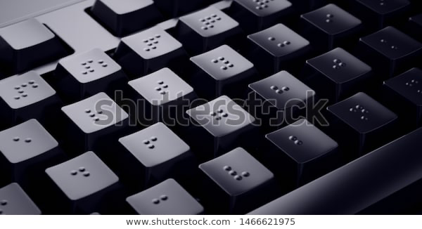
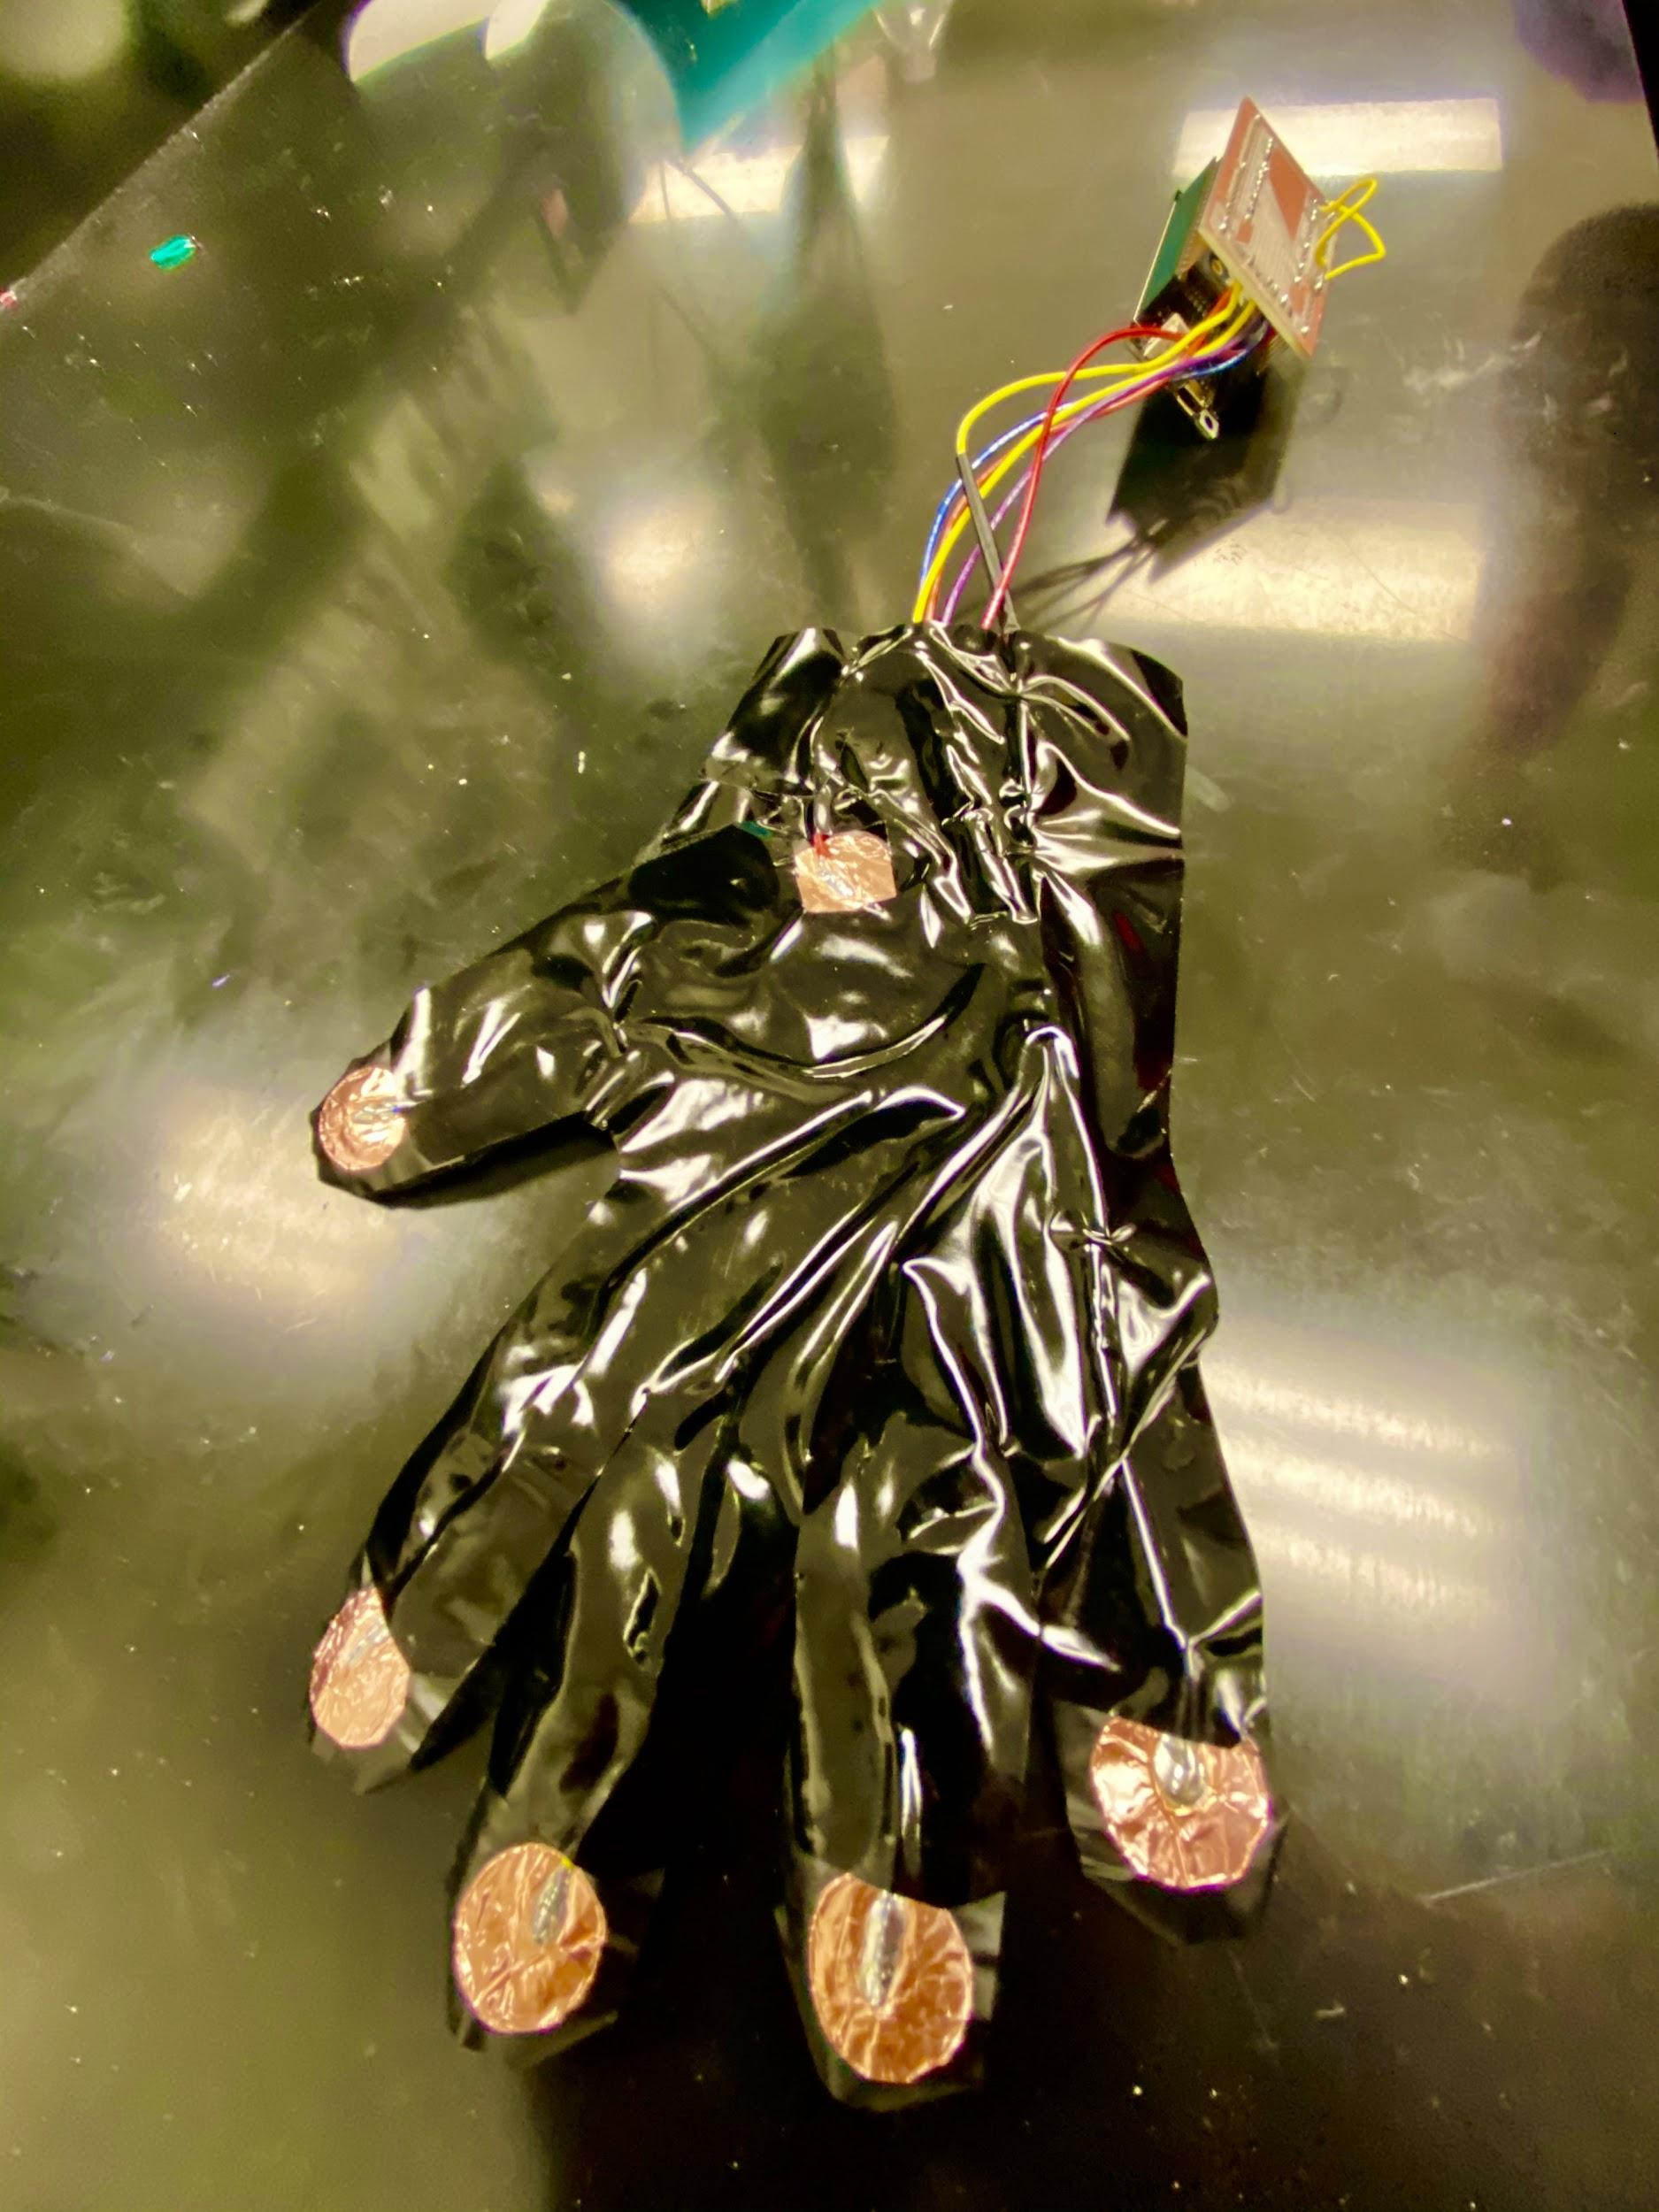
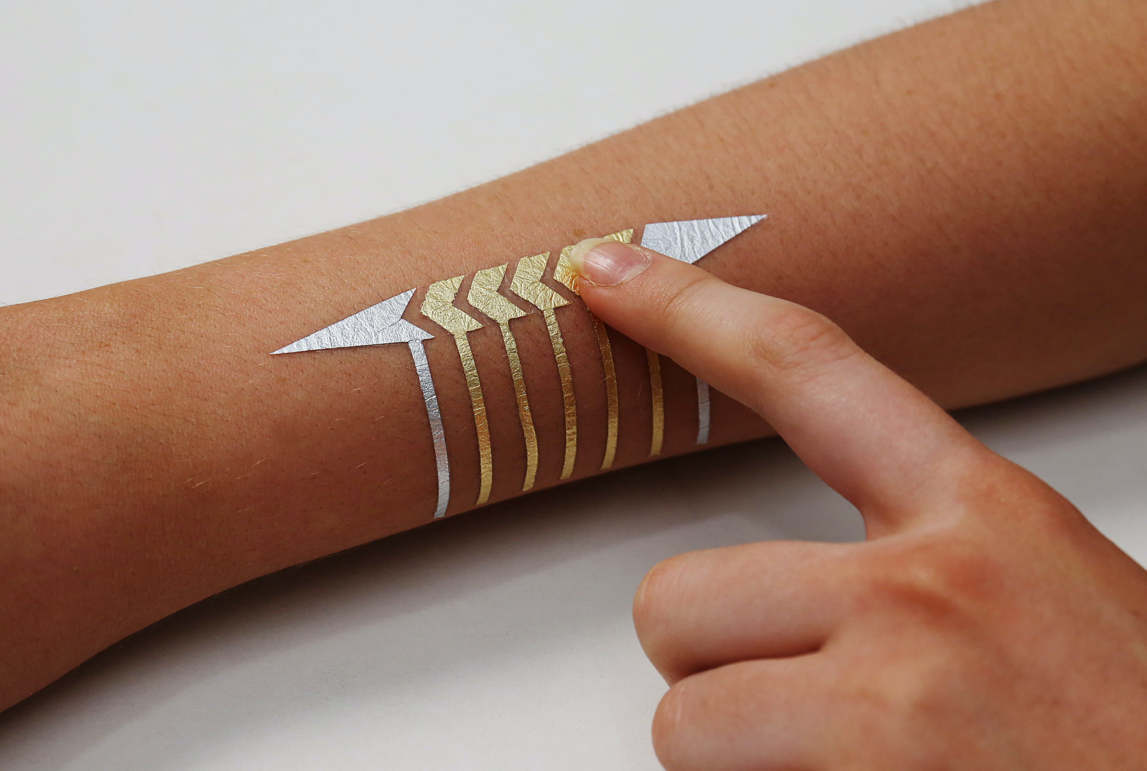
Why?
To be discrete
How?
5 keys on 5 fingertips
5 letters each mapped onto 4 of the keys and 6 letters onto 1 key
1 key on the palm
Audio feedback
Notes:
The idea was to empower smart tattoos applied on the finger tips, for hardware and time costraints we had to change towards a glove, but this would be a prototype of the final device
5 keys… with vocal feedback

Slide 3
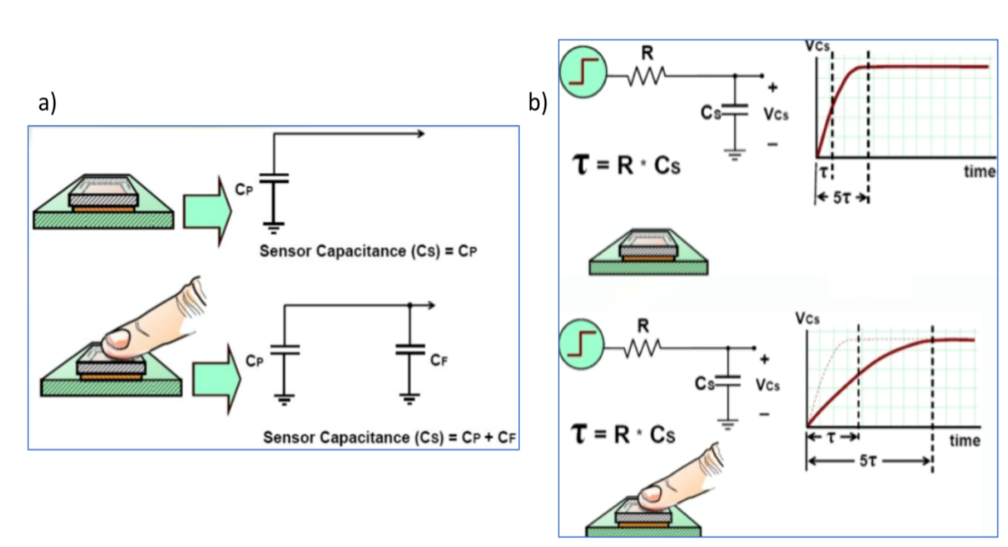
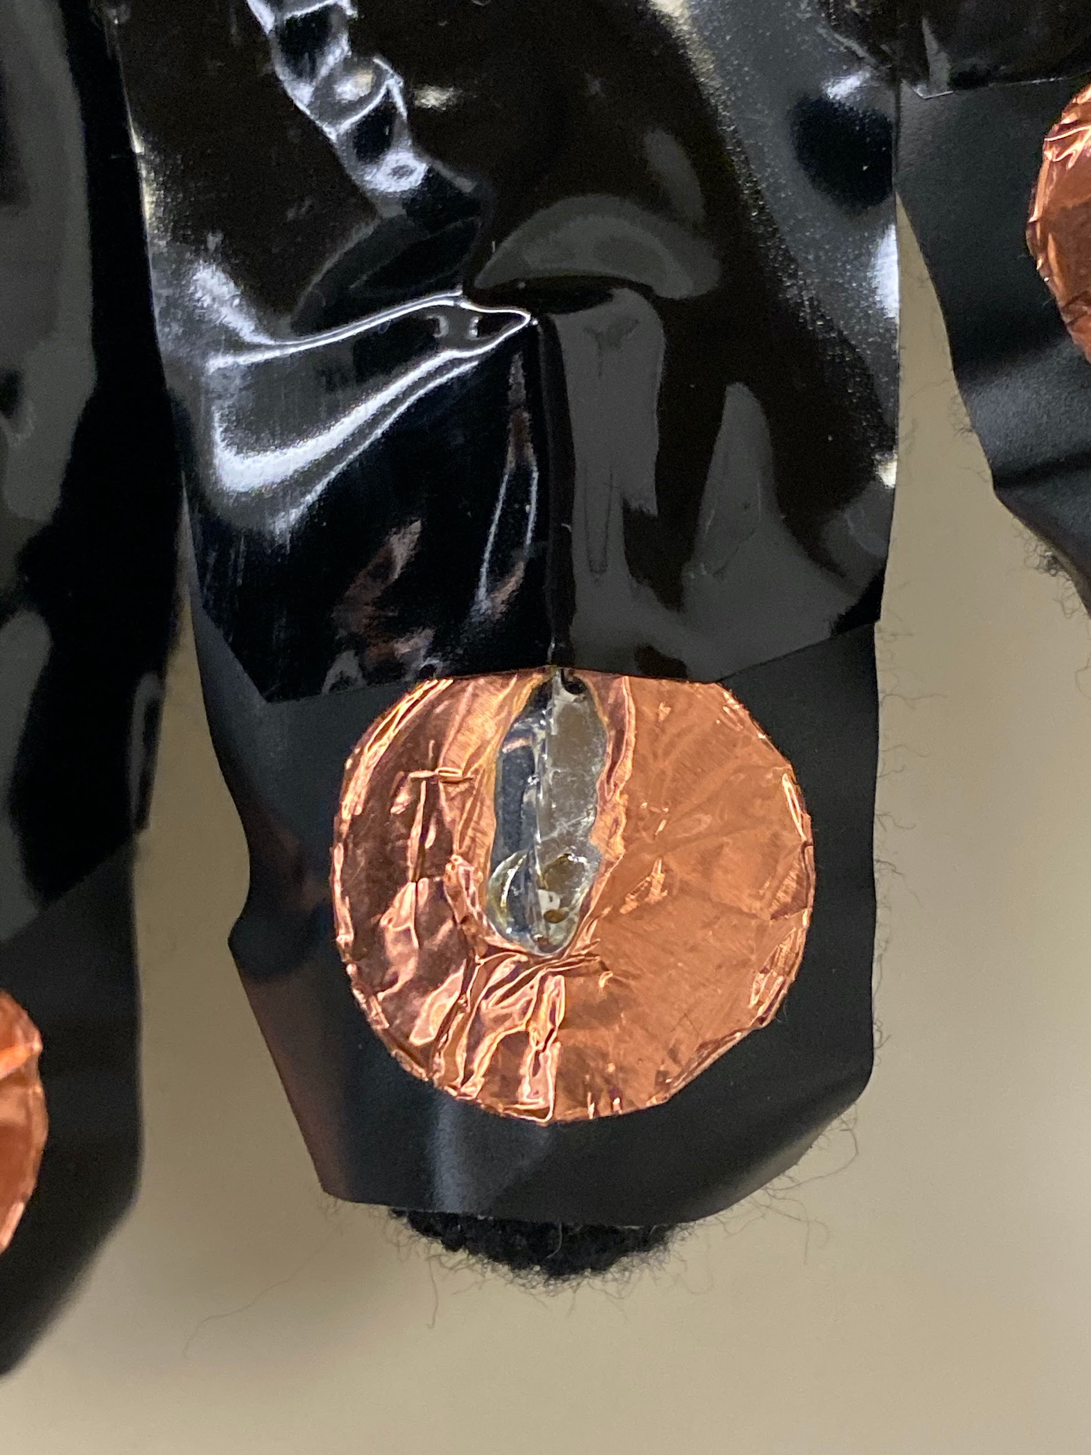
Capacitive sensing
Detection of a conductive object approaching the pad surface by measuring the capacitance
In this case detection of the body skin or of any other conductive surface
Notes:
Smart tatoos are based on capacitve sensing, which allows to detect a touch of finger or of any conductive object by measuring a change in capacitance.
In lab 4 we measured the approaching of a finger, for this device we decided to invert the fucntioning indeed we measure when the finger approaches a conductive surface such as the skin or a conductive surface such as a desk

Slide 4
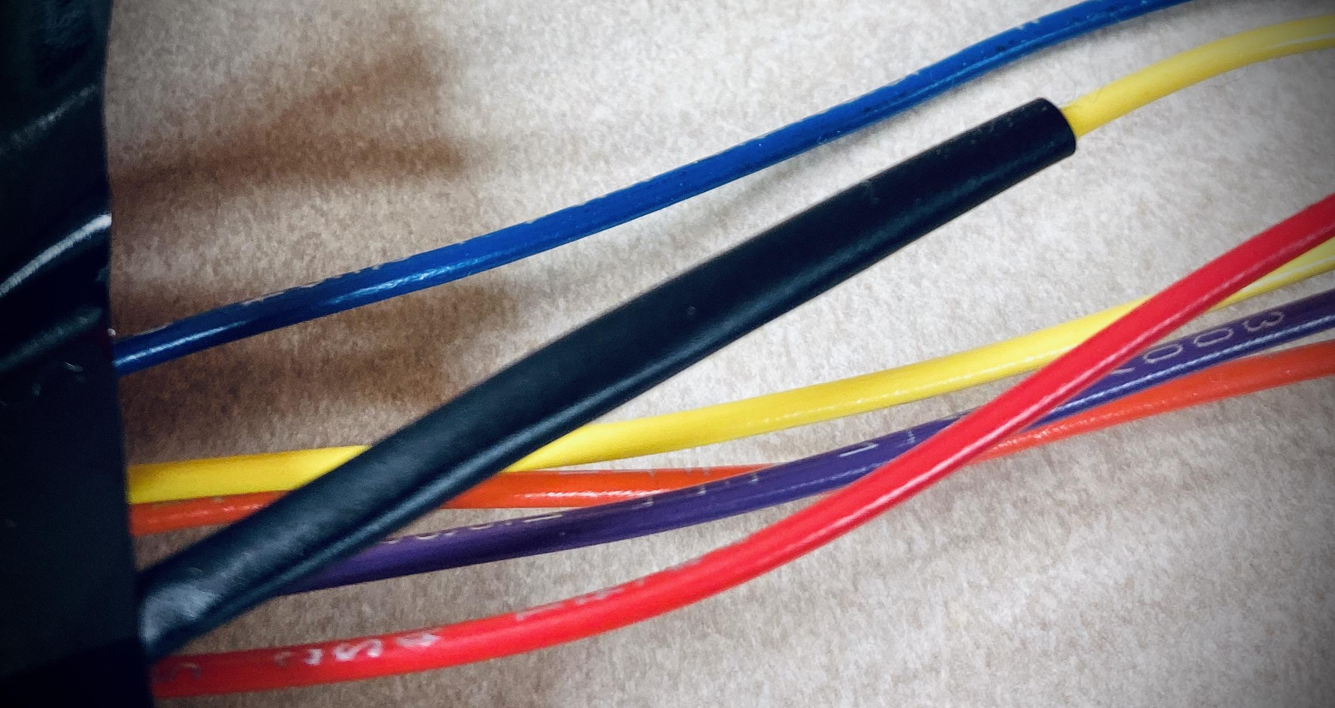
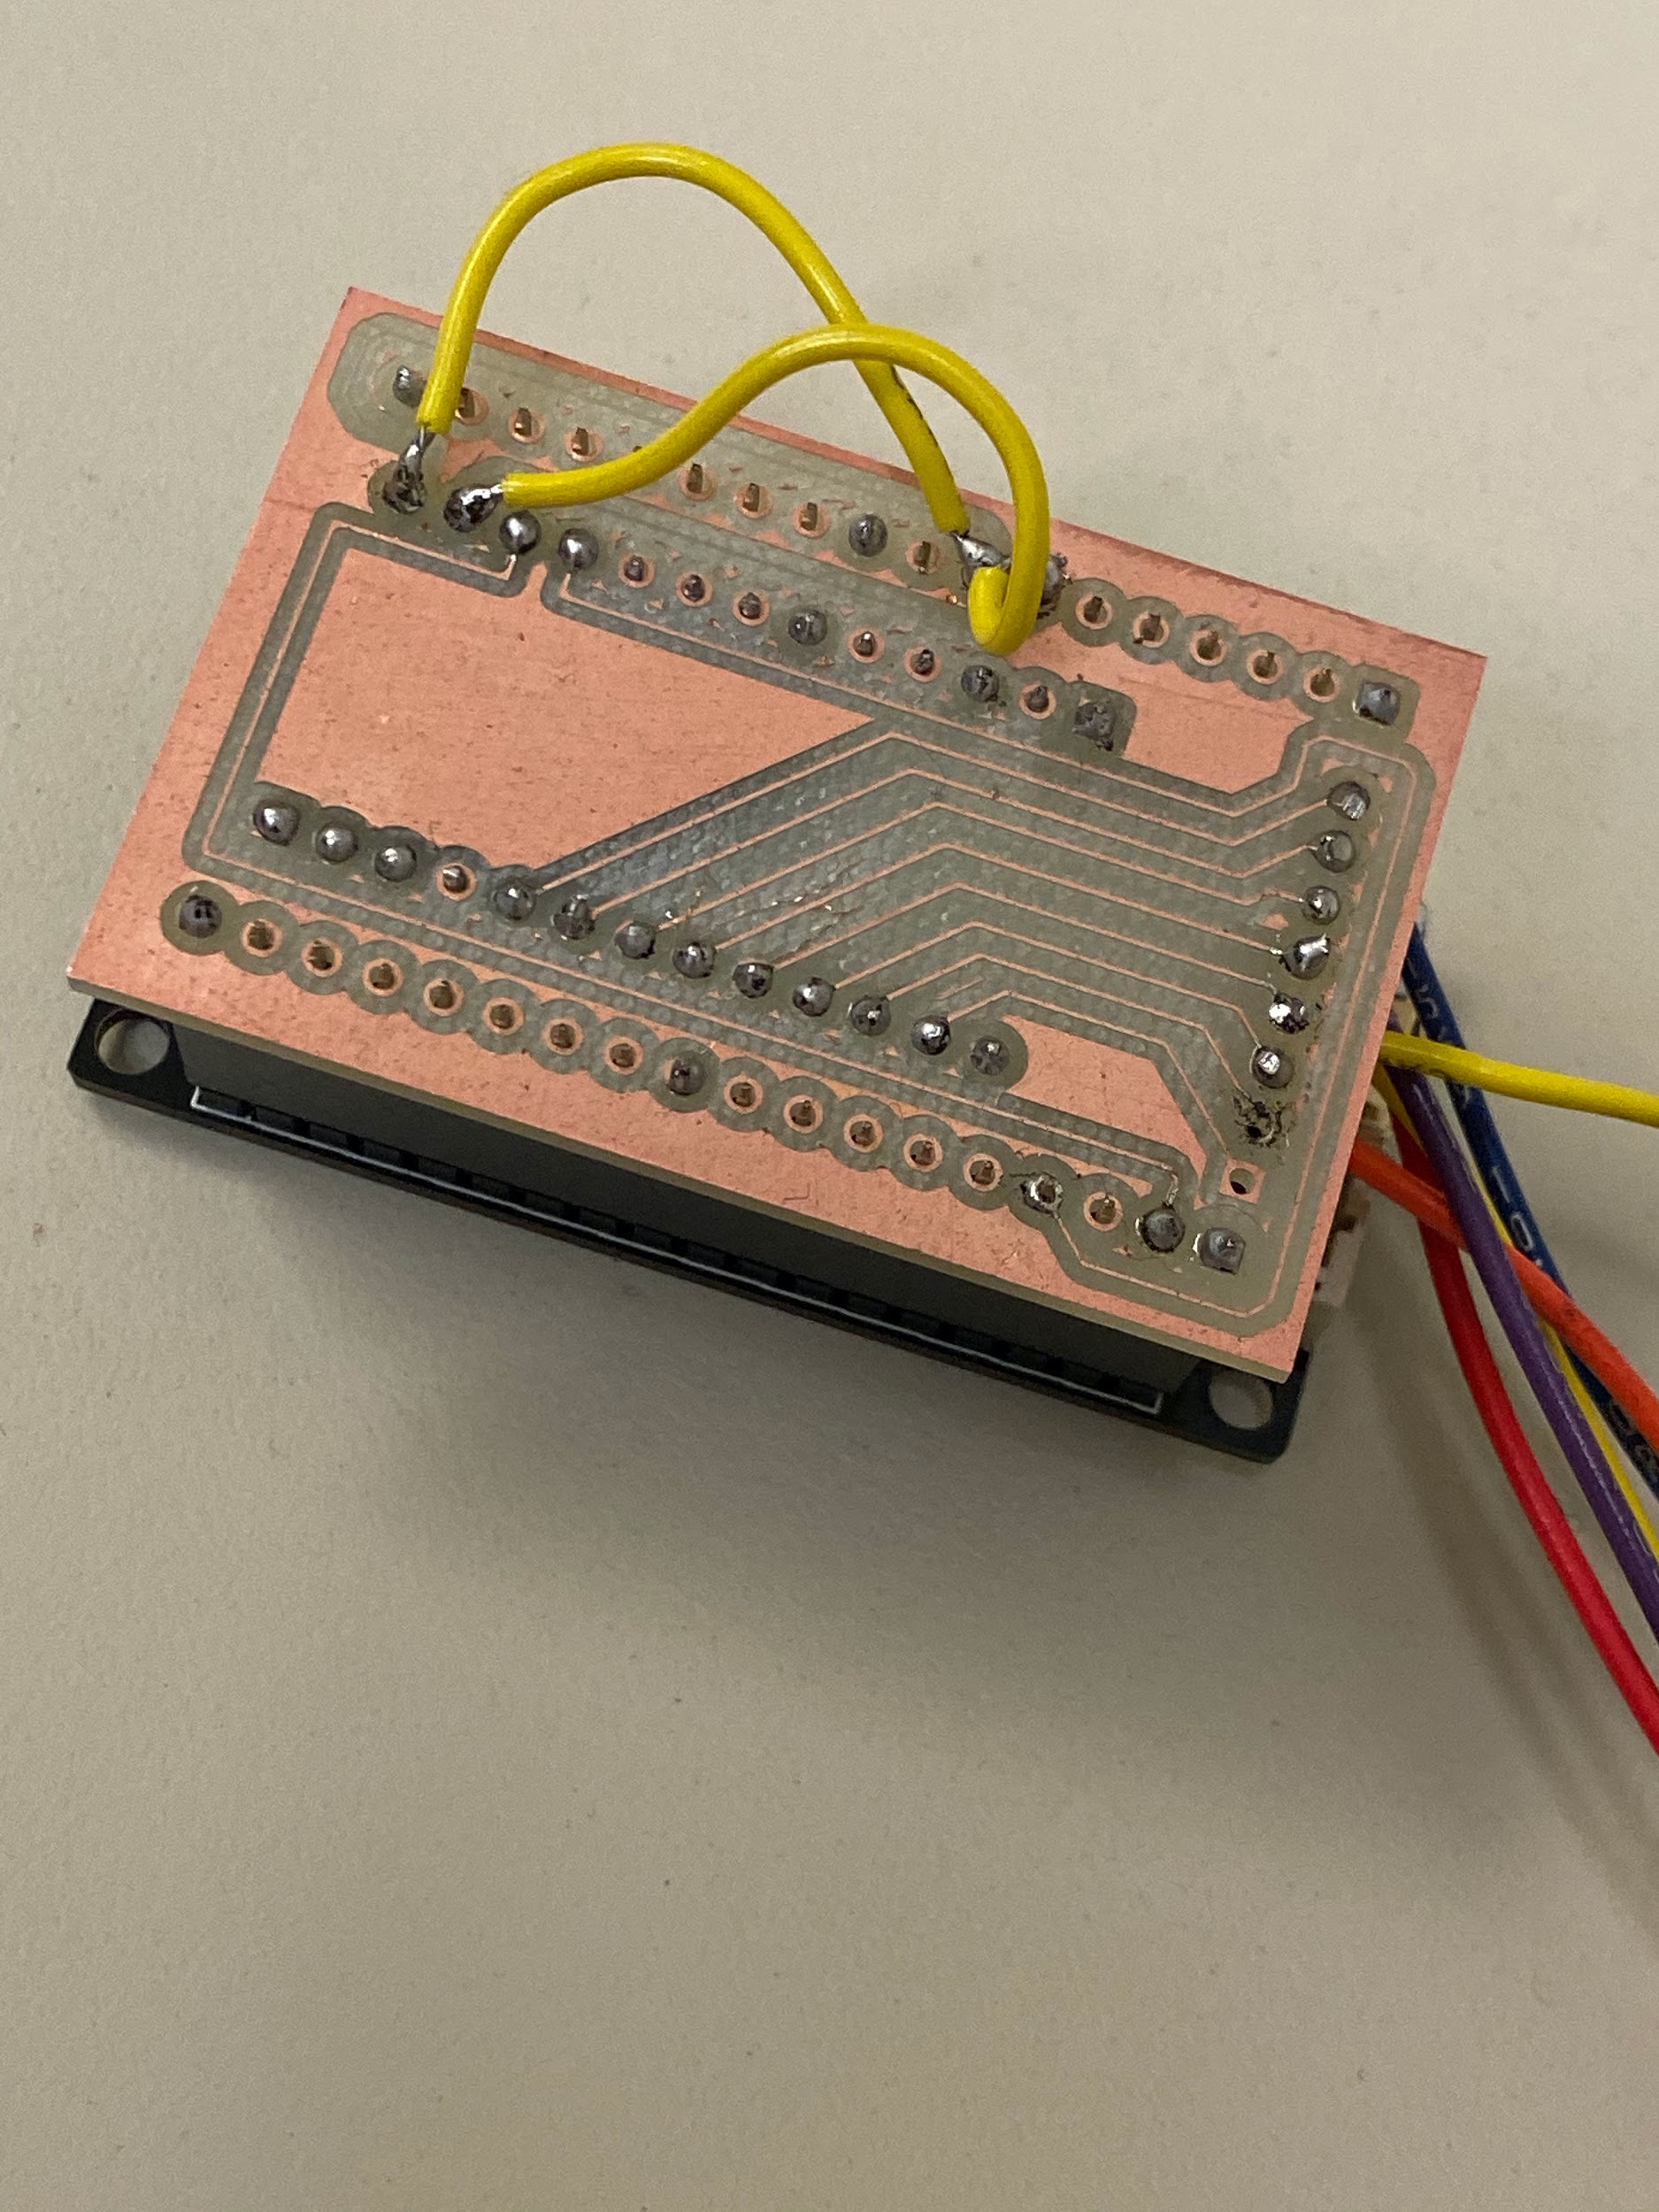
Prototyping: Main issues
Tuning of the sensitivity to:
Avoid wires cross talk
Avoid grounding with skin under the glove
Shielding of the wires through insulating plastic material
Traces dimensions
Notes:
We tried to solve the issues such as: wires cross talks...
With the aim to detect the capacitance created only by an approach of the finger to a conductive surface
So we had to perfectly isolate the pad from the finger skin

Slide 5
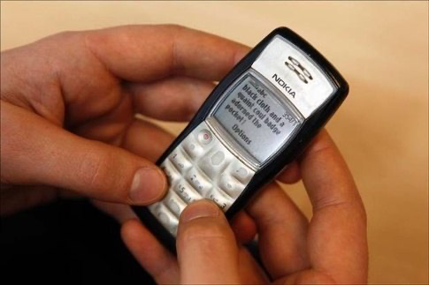
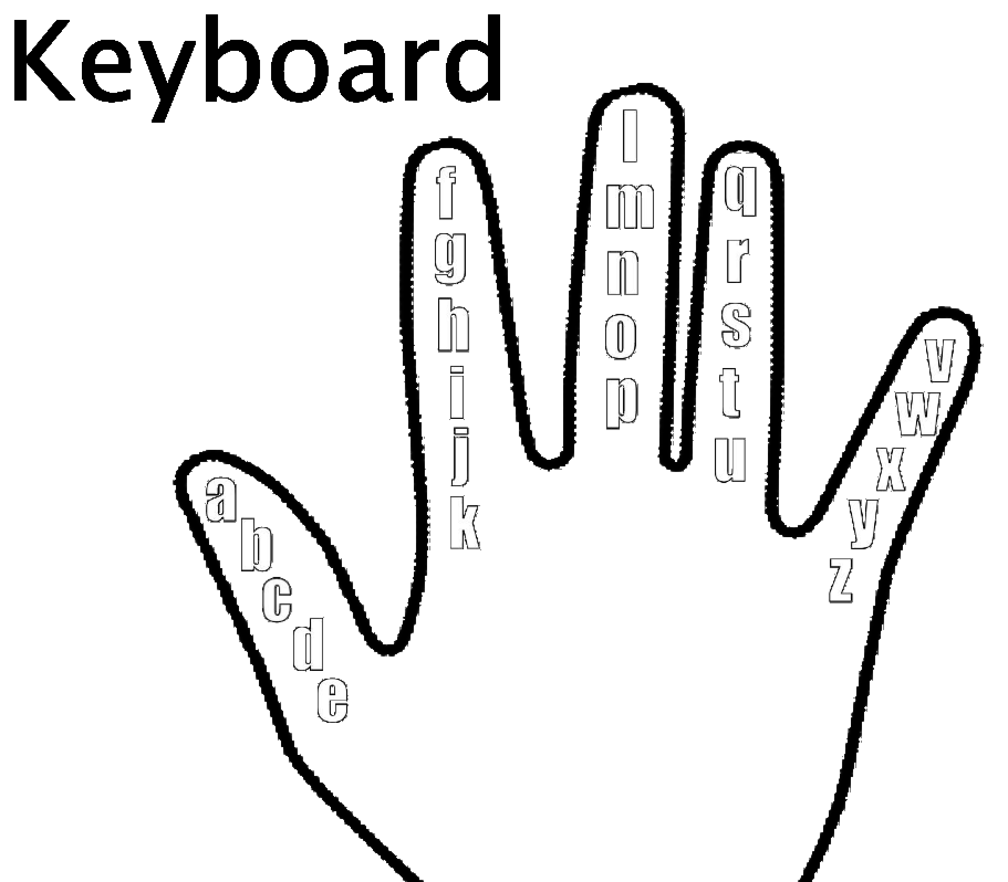
T9 Style
2 ways of confirming a letter:
By tapping with a second finger to write the following letter
By waiting a timer to reach a certain fixed delay that confirms the letter insertion
Notes:
Each key allows for typing of multiple letters by quickly tapping with the finger the number of times to reach the index of the letter

Slide 6

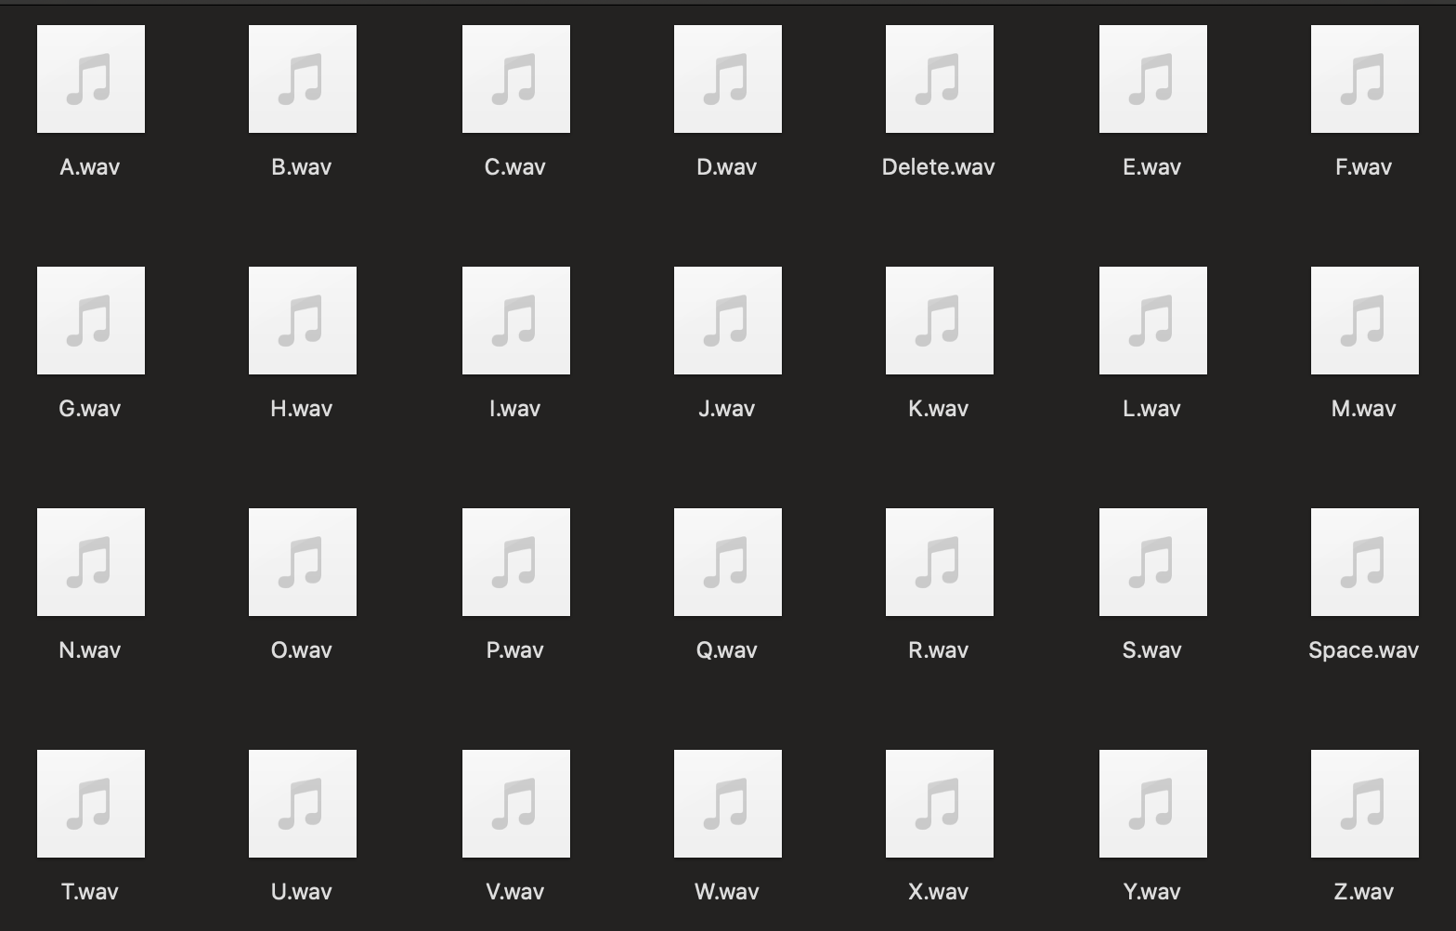
Vocal feedback
To help the user understand what he’s actually typing.
Each time a letter insertion is confirmed a vocal sound is reproduced representing:
The typed letter
The performed action such as:
spacing
deleting

Slide 7
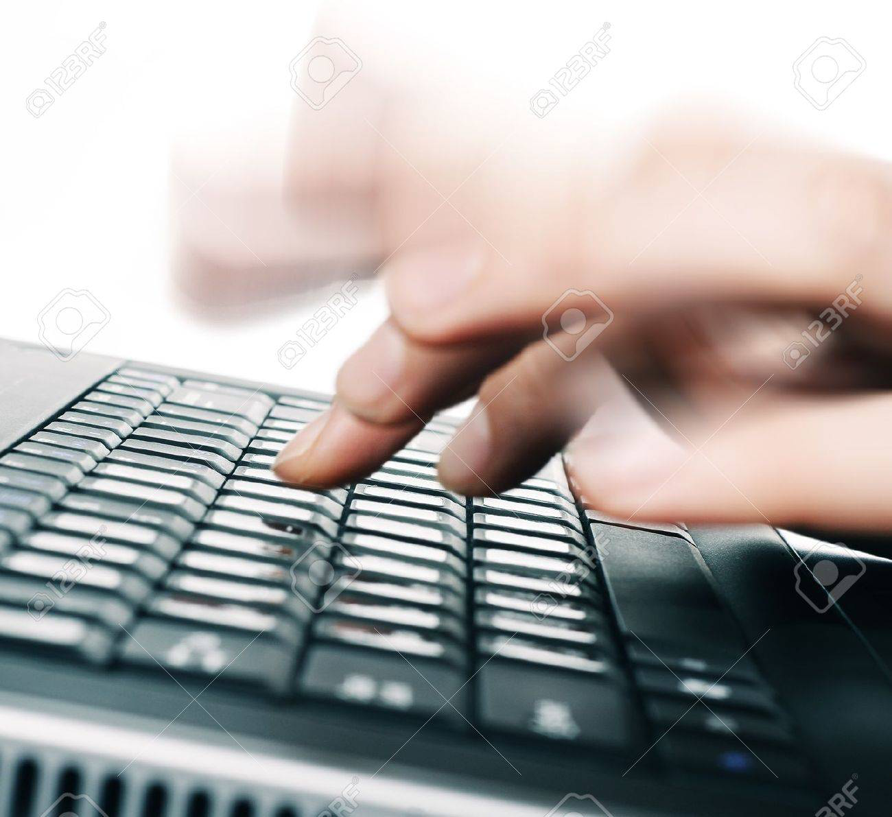

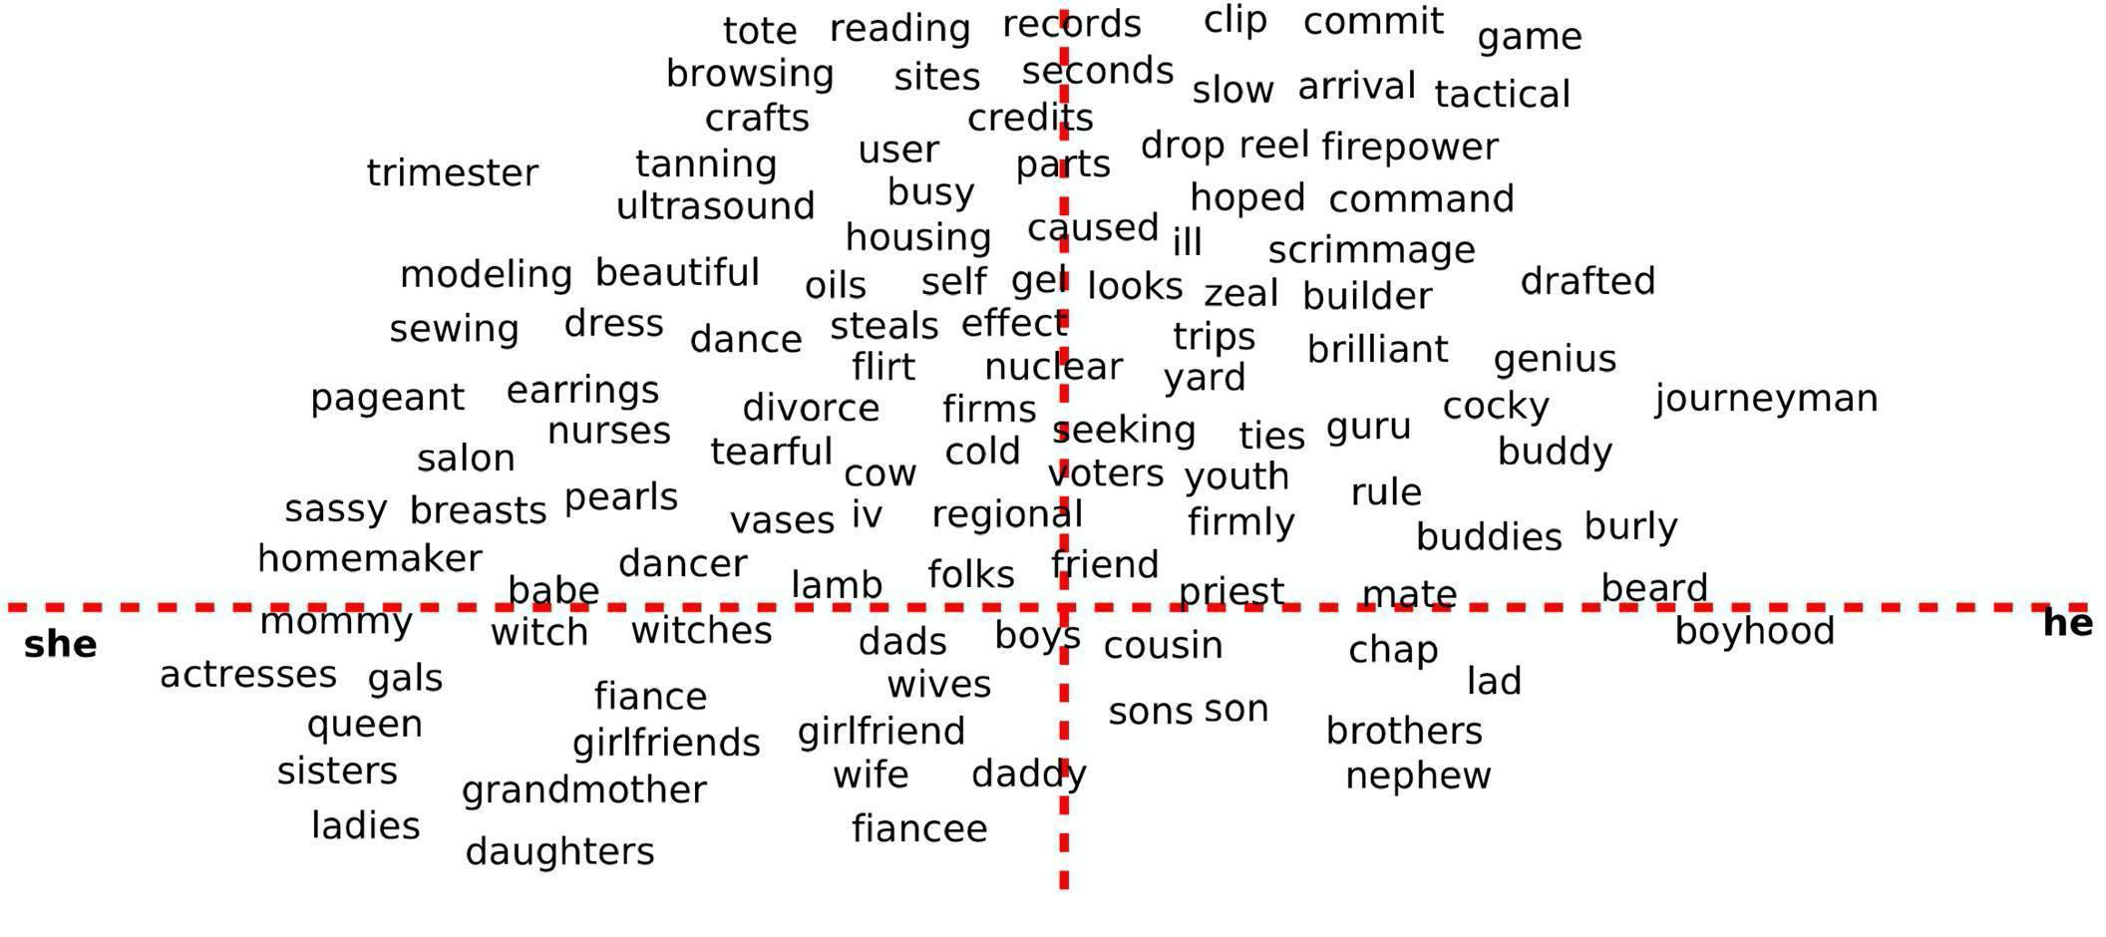
Limitations and future improvements:
Dynamical update of the confirming letter delay
Extending keyboard, shorter learning curve
Introduce predictive algorithms
Add more vocal feedbacks
Notes:
Auto update of the confirming letter delay in the algorithm based on the typing speed of the subjects, so that if you type fast the delay would decrease
Extending keyboard to both hands fingers to reduce the number of letters per finger, so to have 10 fingers and 2 palm writing, that would allow to shorten THE LEARNING CURVE of a new user because you won’t have 5-6 fingers for each finger
Introduce predictive algorithms to forecast the word being typed with successive feedback on the prediction to the user, so that if you start typing it will understand what you want to type and tell you the word
Add more vocal feedbacks

Slide 8
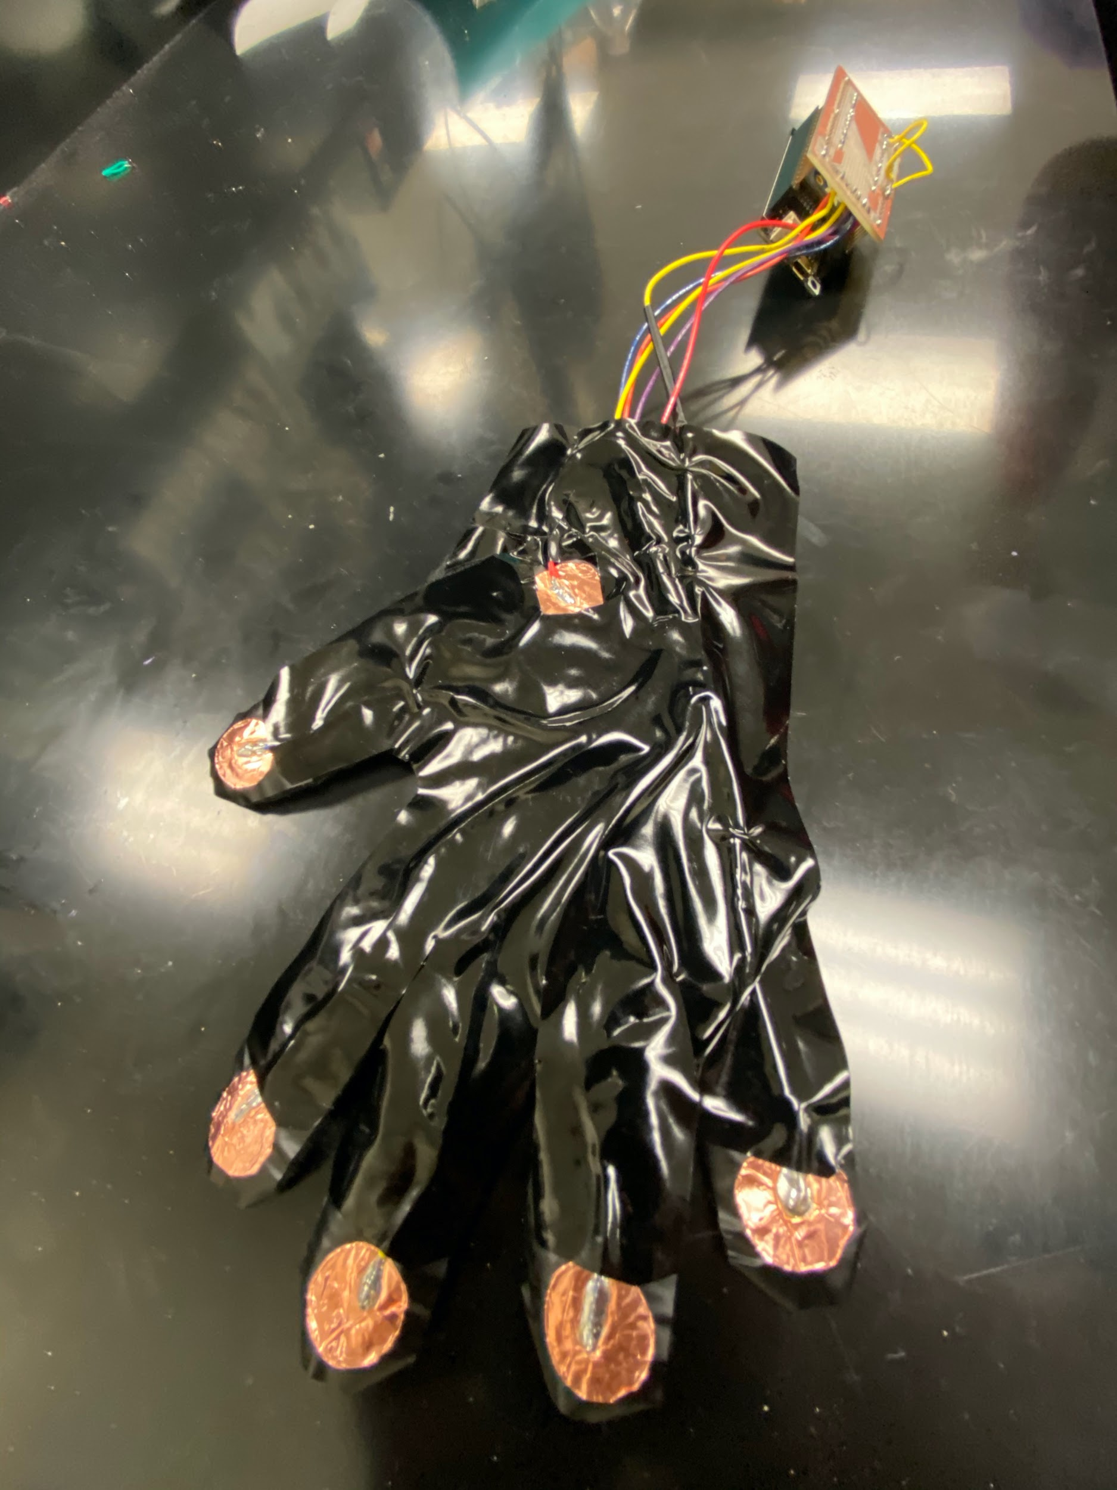
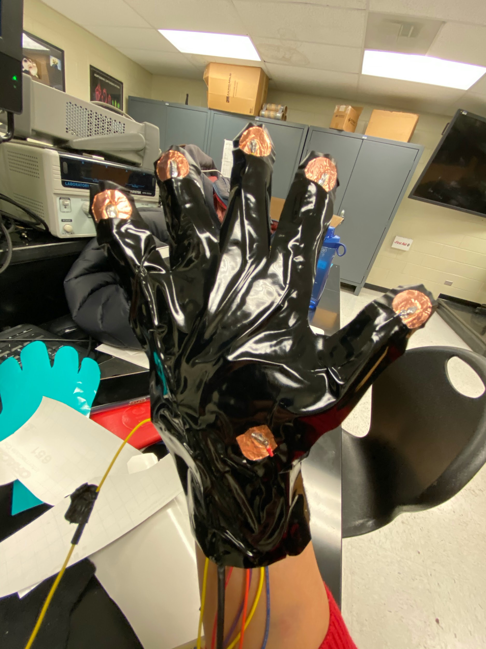
Final Device

Slide 9

Demo

Slide 10
Demo 2

Slide 11
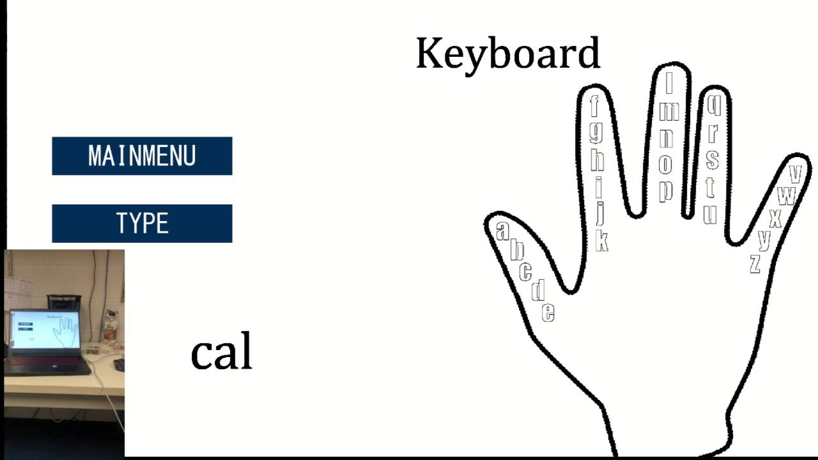
Demo 3

